Slide 1

Windows at Wayfair
Jeff Dillon
System Automation
jdillon@wayfair.com
Classic to Devops

Slide 2
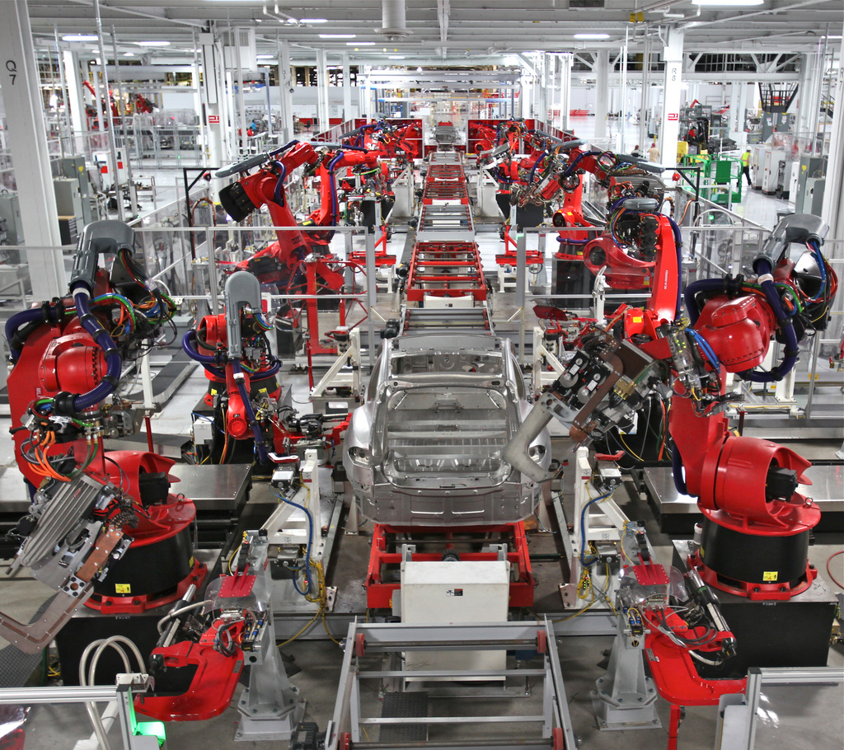
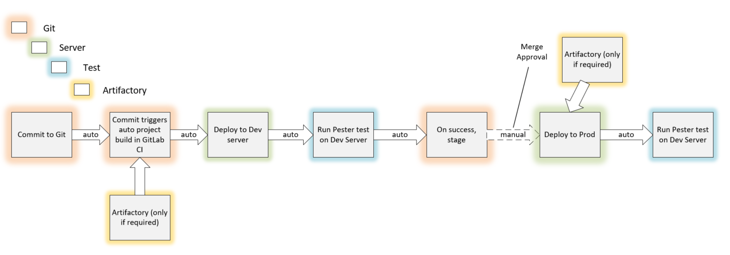
Show the Server Configuration Pipeline!

Slide 3
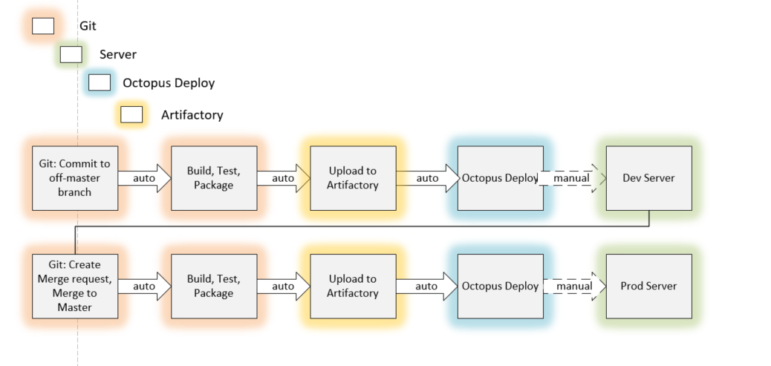
Show the App Code Deploy Pipeline!

Slide 4
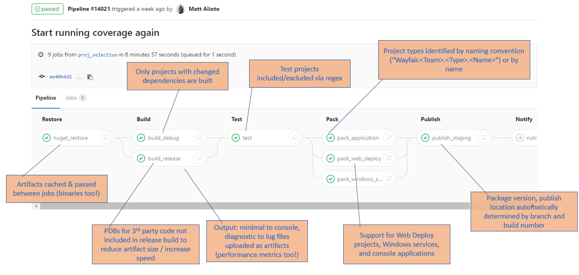
Show the App Code Deploy Pipeline!

Slide 5

Pipeline Version 1.0
First try will be simple
Just prove some automation works
Keep your goals low

Slide 6
Pipeline Version 3.1.1.0

Slide 7
Questions
Jeff Dillon
jdillon@wayfair.com
jdillon@powershell.slack.com
jdillon_wayfair@bostondevops.slack.com

